Slide 1
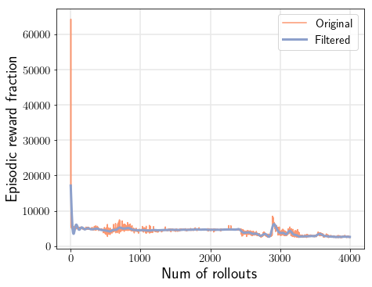
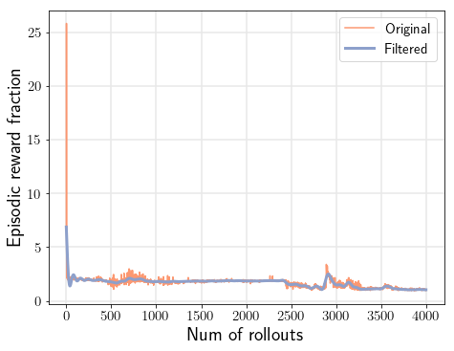
Pendulum
Process noise std=0.00
4000 rollouts

Slide 2
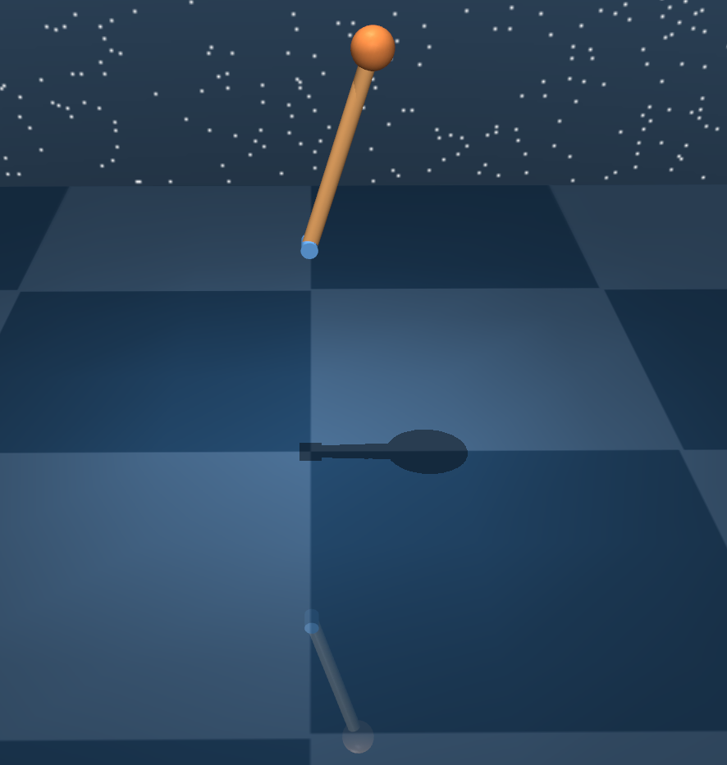
Step 30 keep shaking
Tested with no process noise

Slide 3
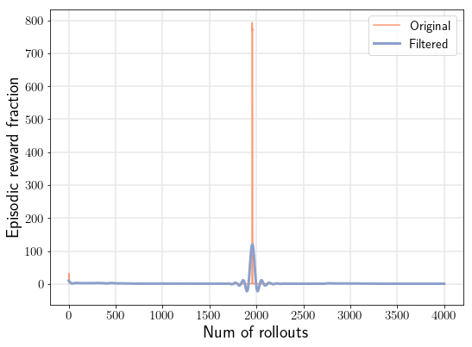
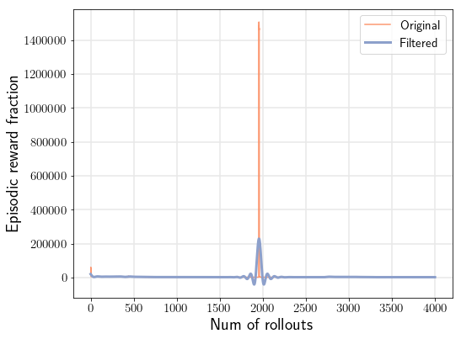
Pendulum
Process noise std=0.01
4000 rollouts
Starts at 22000
Ends at 1800

Slide 4
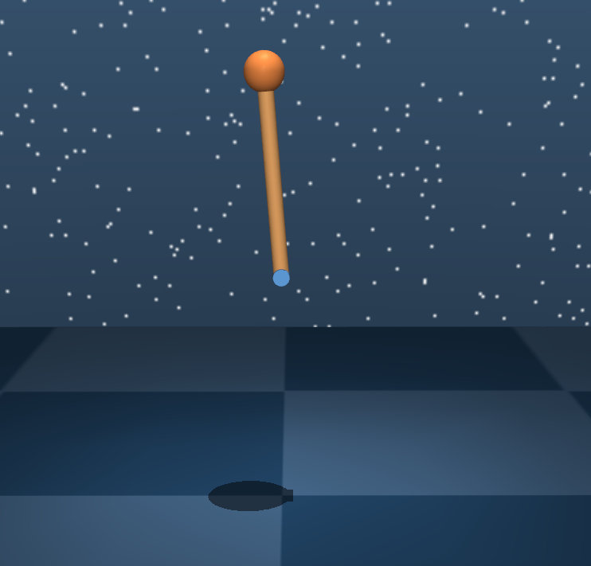
Step 30
Tested with no process noise

Slide 5
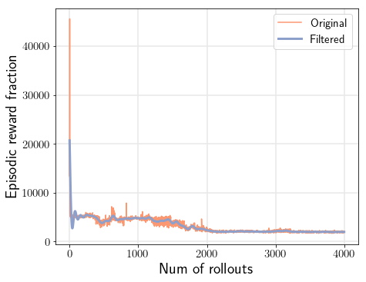
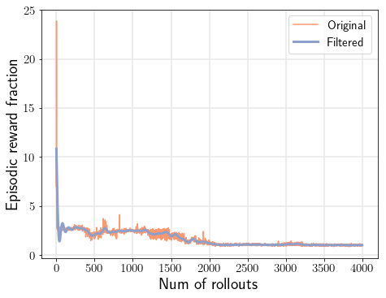
Pendulum
Process noise std=0.05
4000 rollouts
Starts at 22000
Ends at 1900

Slide 6
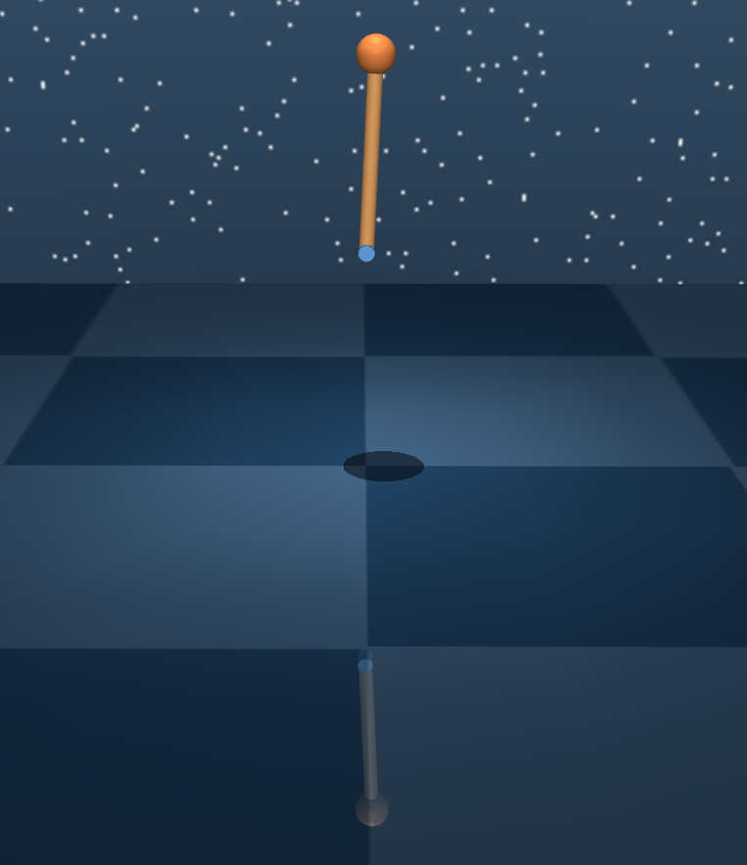
Step 30
Tested with no process noise

Slide 7
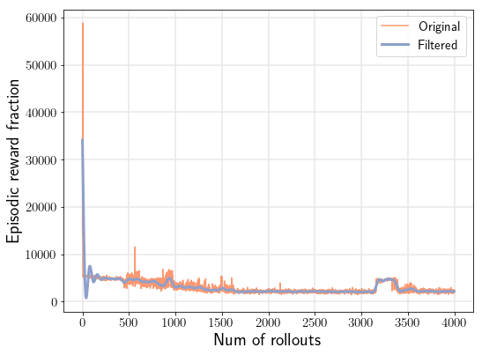
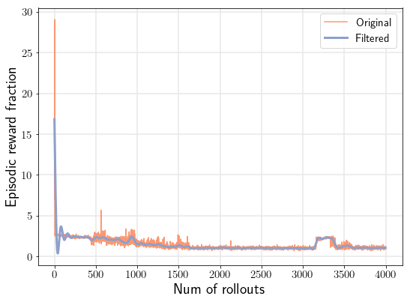
Pendulum
Process noise std=0.1
4000 rollouts
Starts at 35000
Ends at 2000

Slide 8
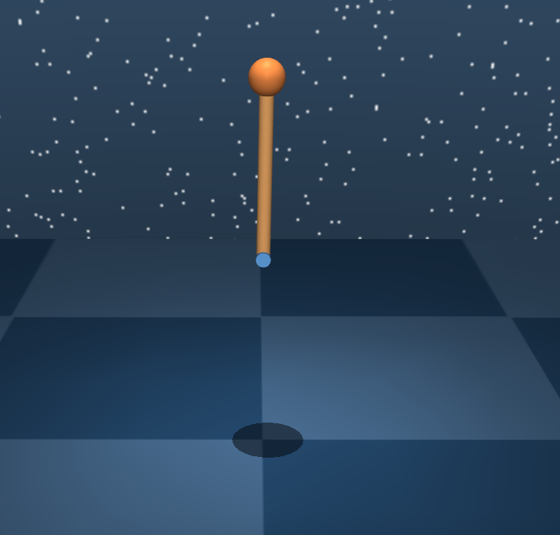
Step 30
Tested with no process noise

Slide 9
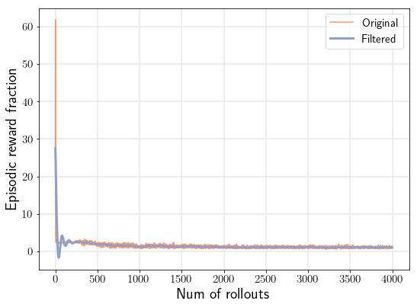
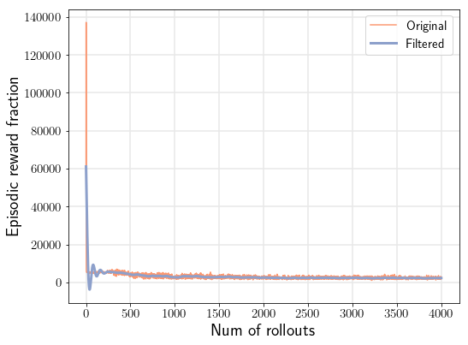
Pendulum
Process noise std=0.2
4000 rollouts
Starts at 60000
Ends at 3000

Slide 10
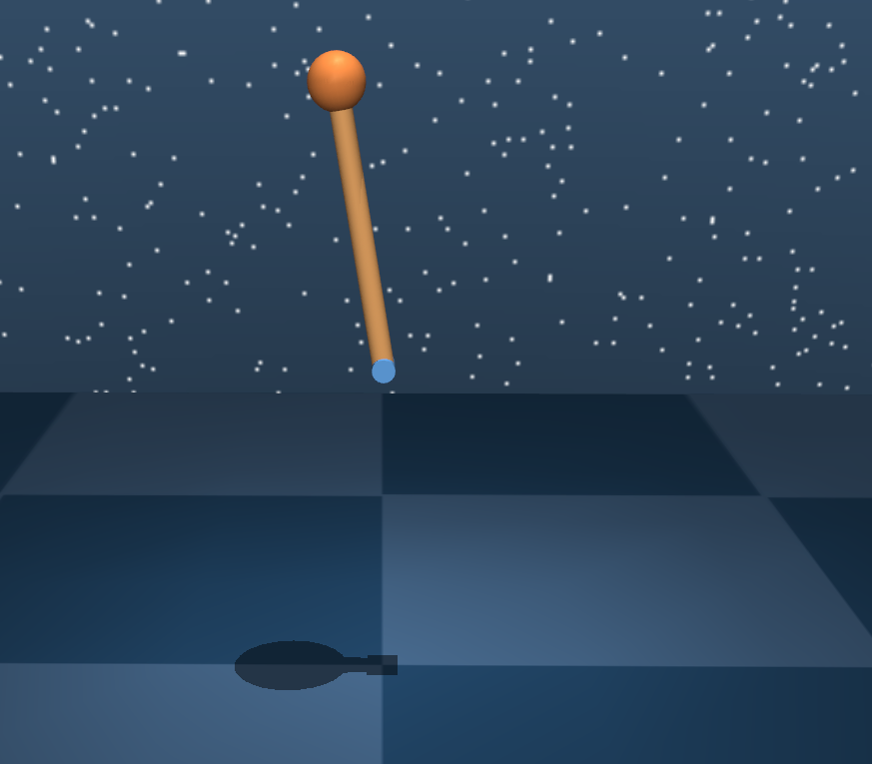
Step 30
Tested with no process noise

Slide 11
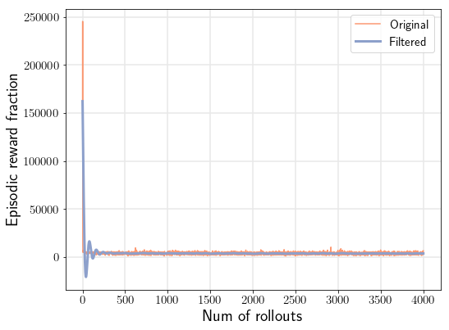
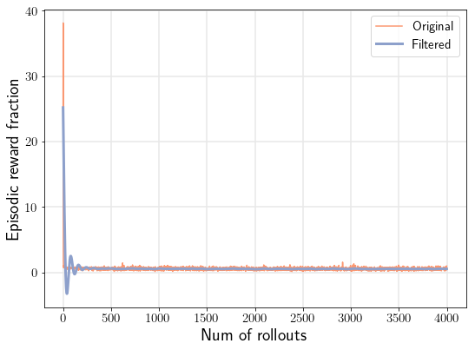
Pendulum
Process noise std=0.5
4000 rollouts
Starts=160000
Ends=6000

Slide 12
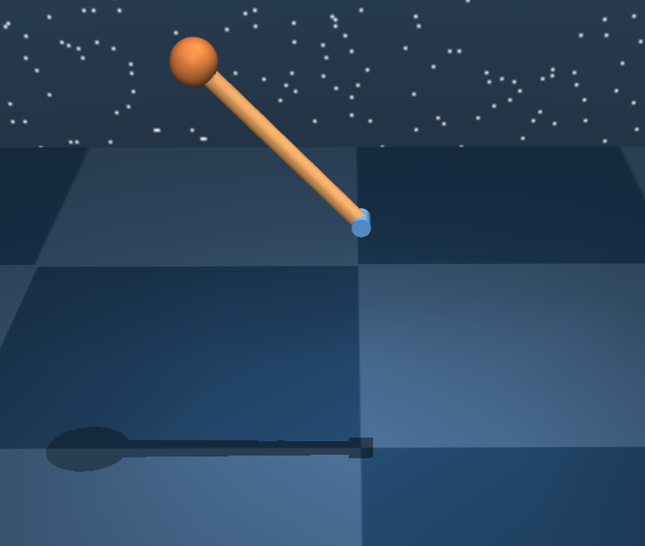
Step 30
Tested with no process noise

Slide 13
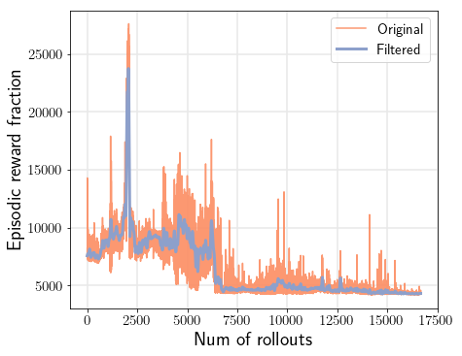
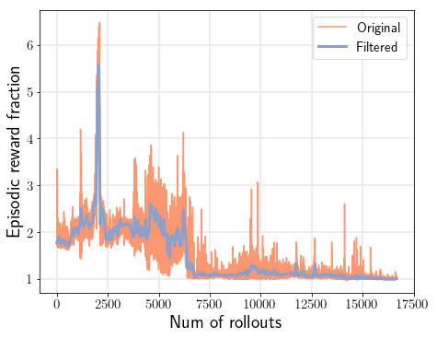
Cartpole
Process noise std=0.00
17000 rollouts

Slide 14
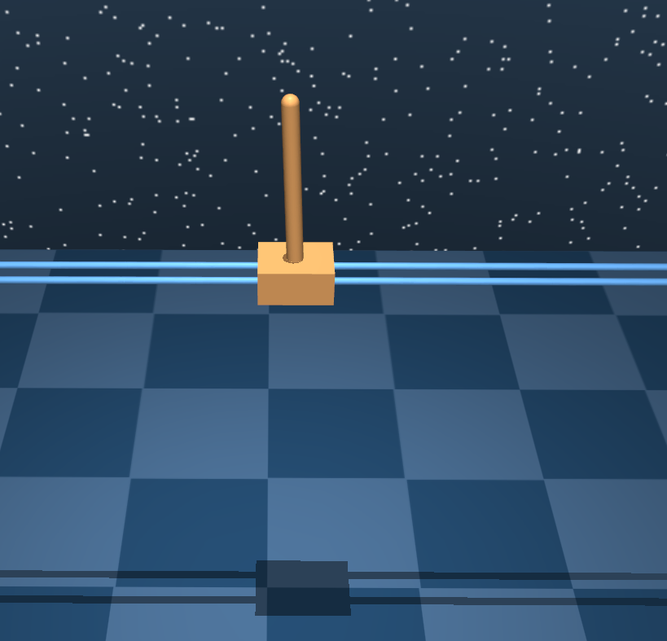
Step 30
Tested with no process noise

Slide 15
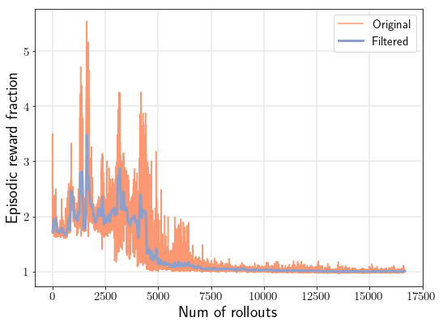
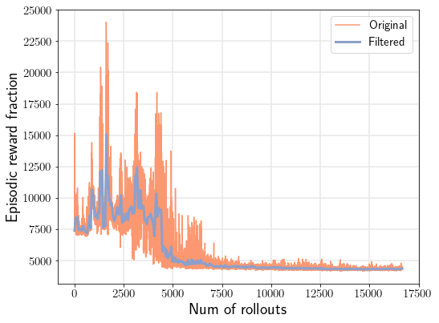
Cartpole
Process noise std=0.01
17000 rollouts
Starts=7500
Ends=4300

Slide 16
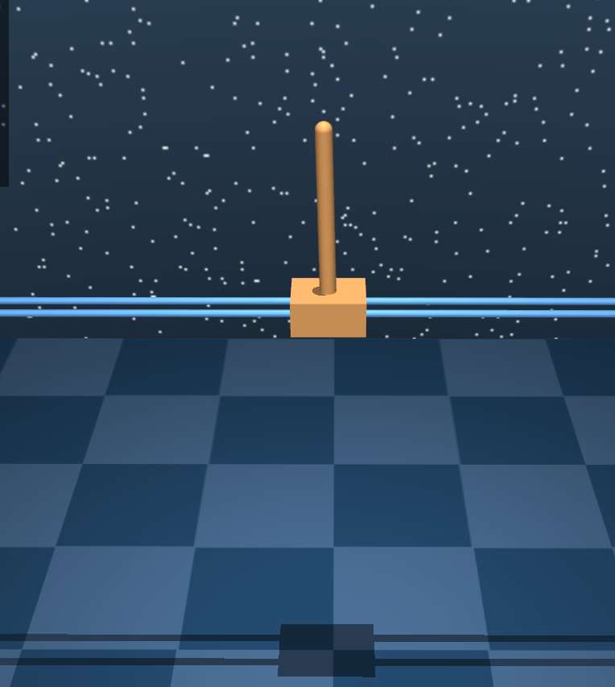
Step 30
Tested with no process noise

Slide 17
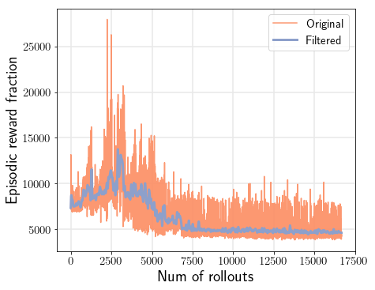
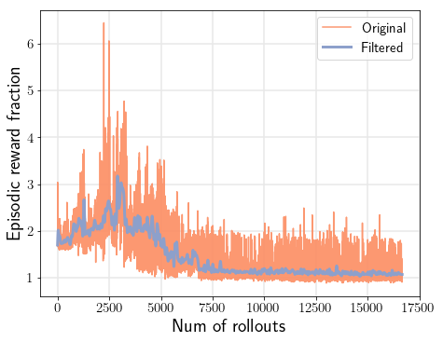
Cartpole
Process noise std=0.05
17000 rollouts

Slide 18
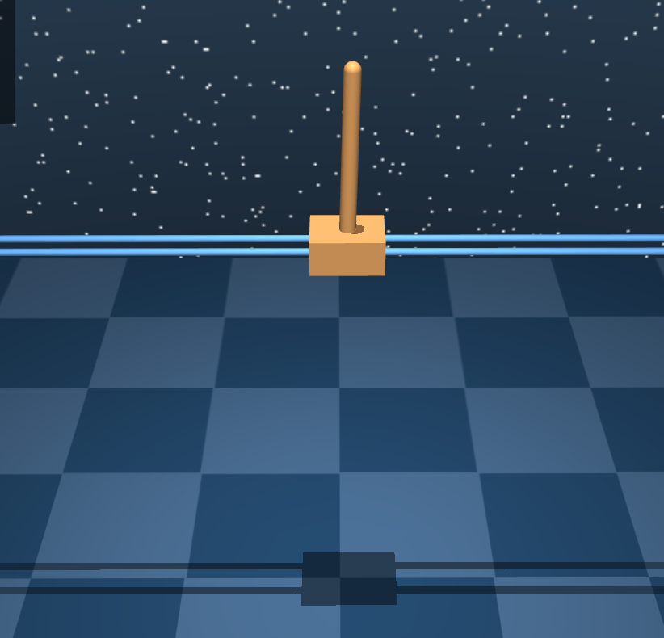
Step 30
Tested with no process noise

Slide 19
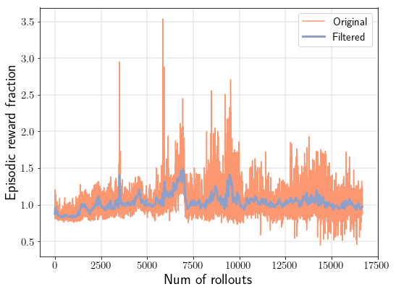

Cartpole
Process noise std=0.1
17000 rollouts
Starts=7500
Ends=8300

Slide 20
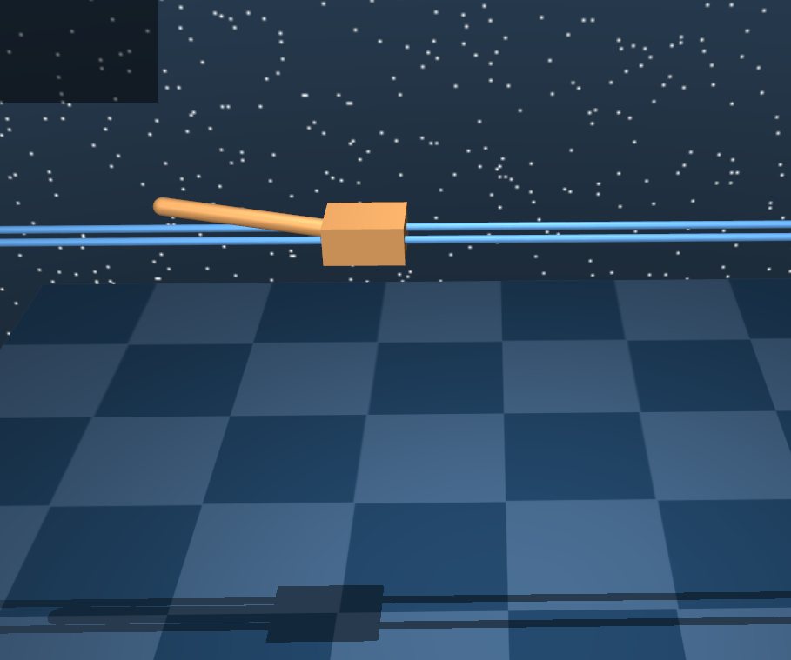
Step 30
Tested with no process noise

Slide 21
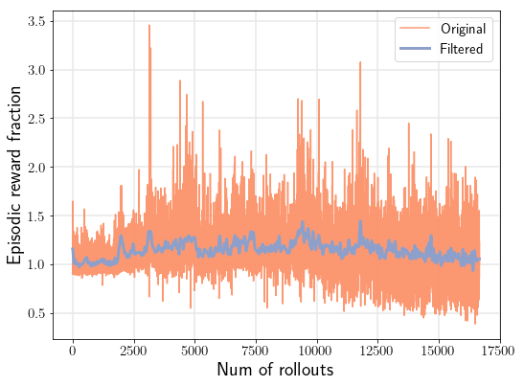

Cartpole
Process noise std=0.2
17000 rollouts
Starts=8500
Ends=7300

Slide 22
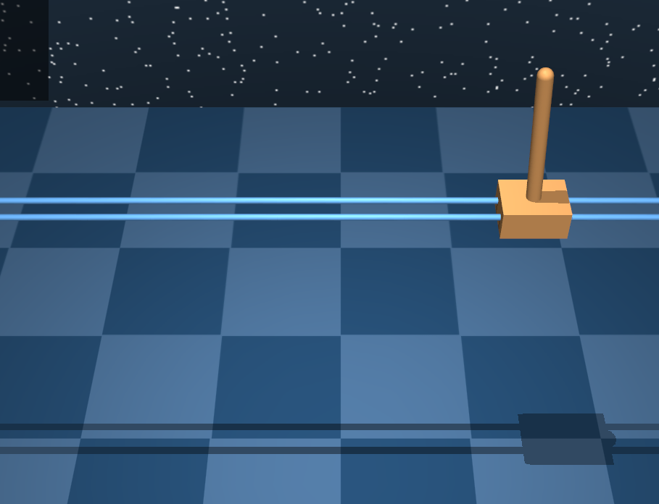
Step 30
Tested with no process noise

Slide 23
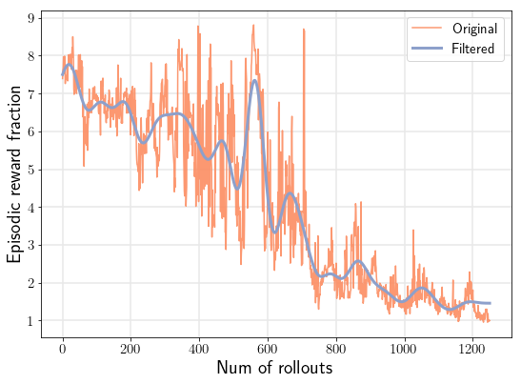
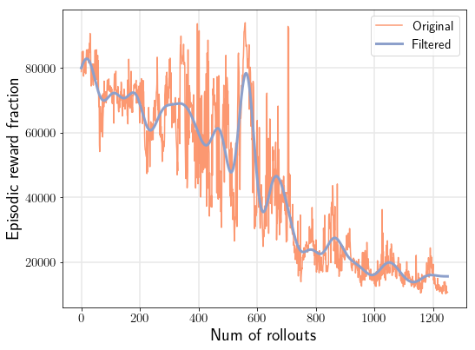
Swimmer3
Process noise std=0
1220 rollouts

Slide 24
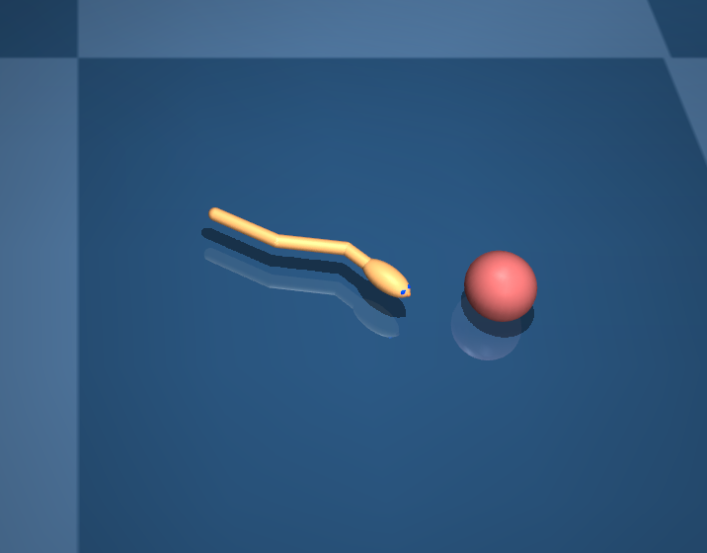
Tested with no process noise

Slide 25
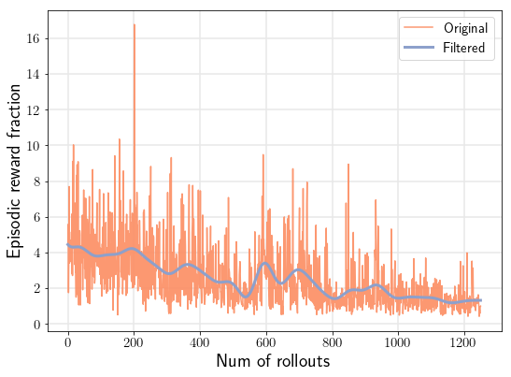
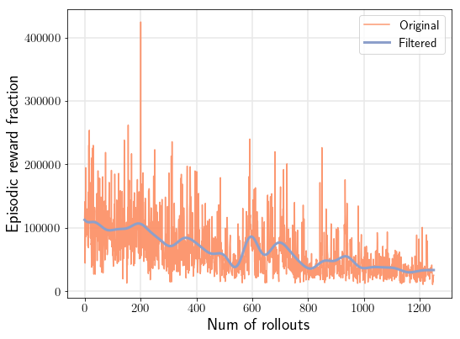
Swimmer3
Process noise std=0.01
1220 rollouts

Slide 26
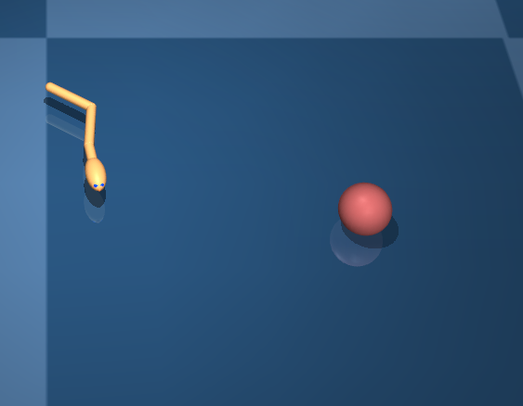
Tested with no process noise

Slide 27
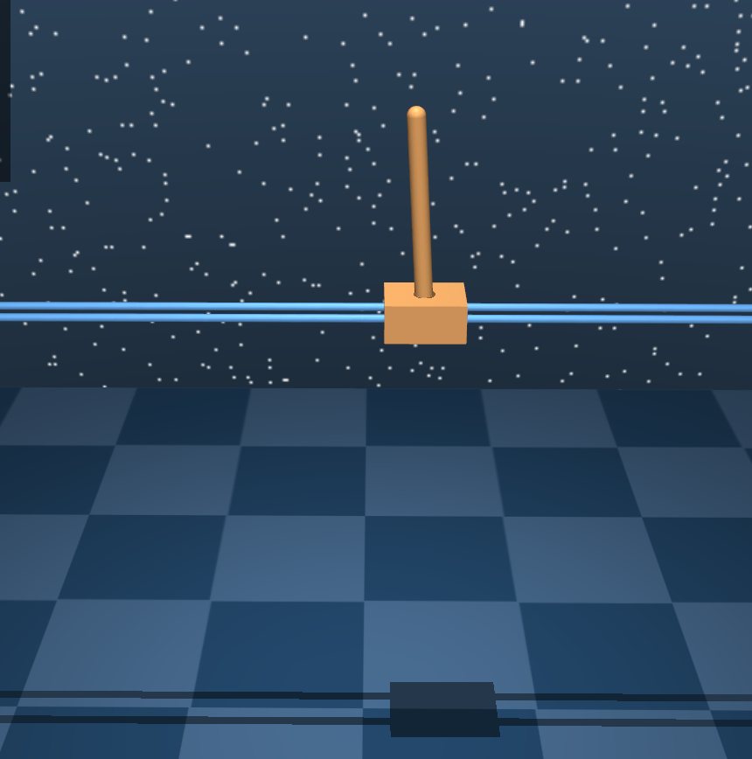
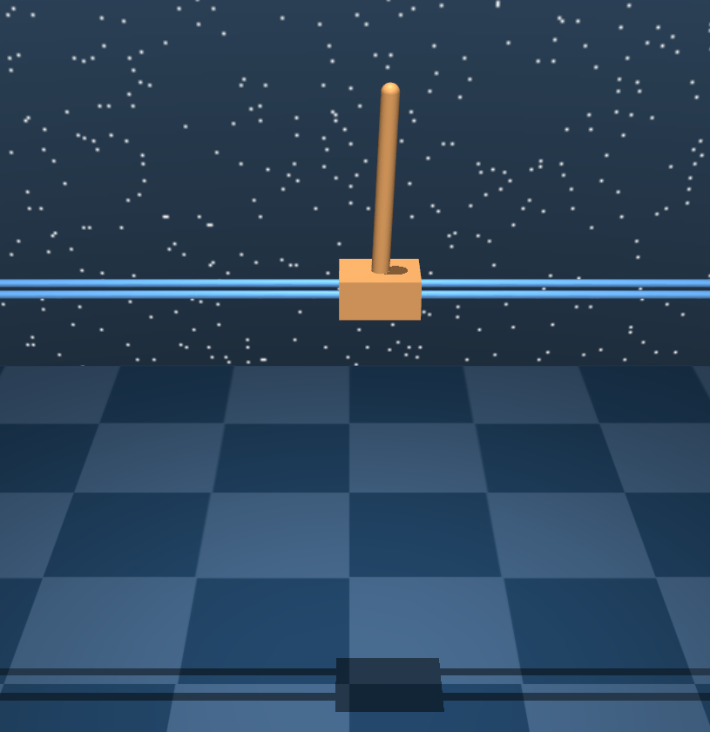
Cartpole
Training process noise std=0.01
Testing process noise std=0
Testing process noise std=0.01

Slide 28
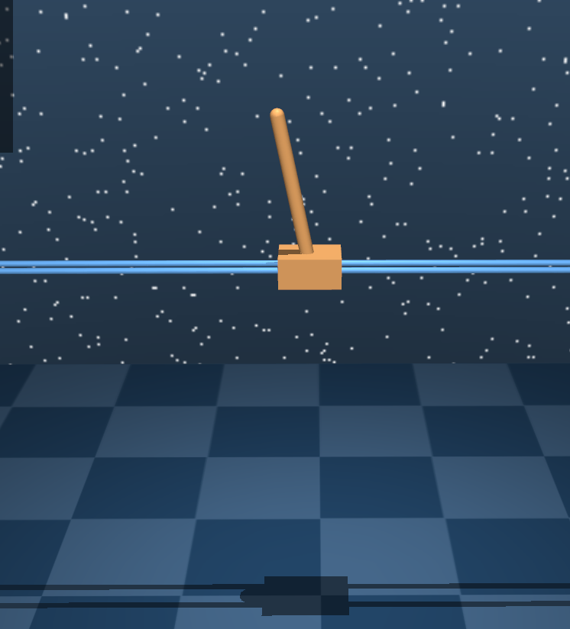
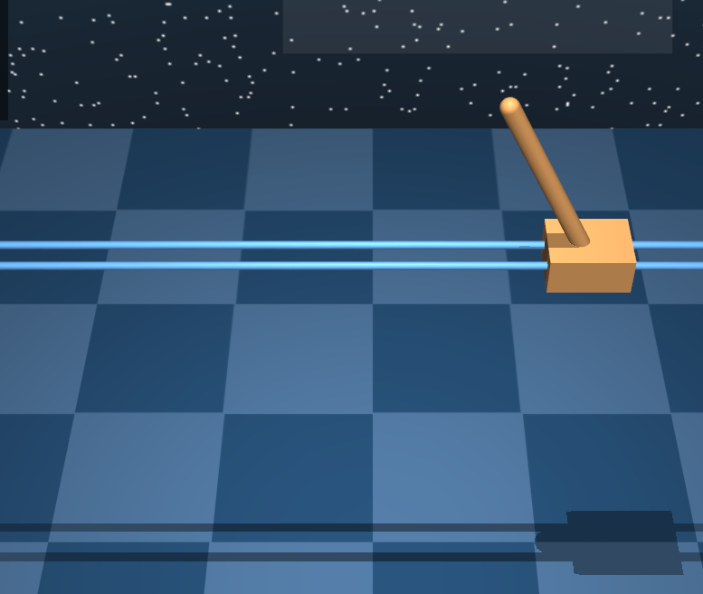
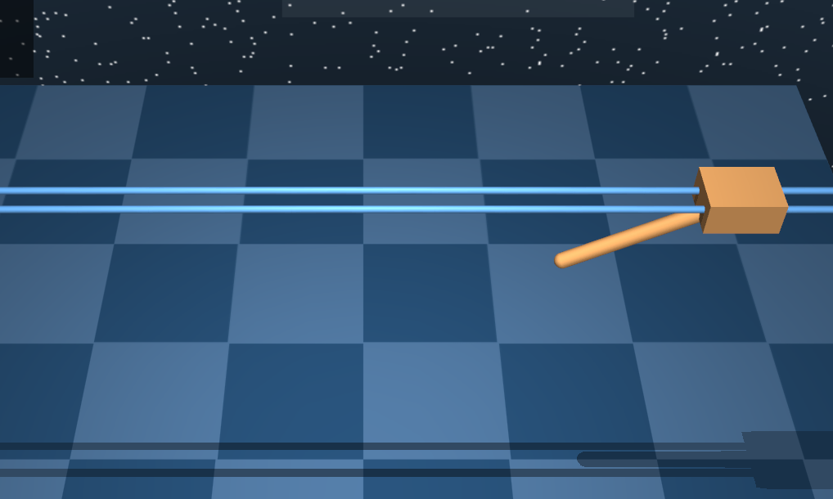
Cartpole
Training process noise std=0.01
Testing process noise std=0.05
Testing process noise std=0.1

Slide 29
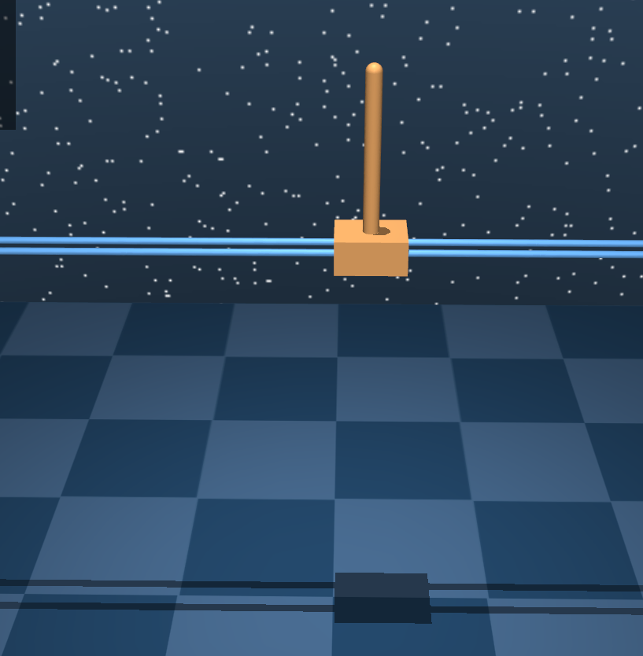
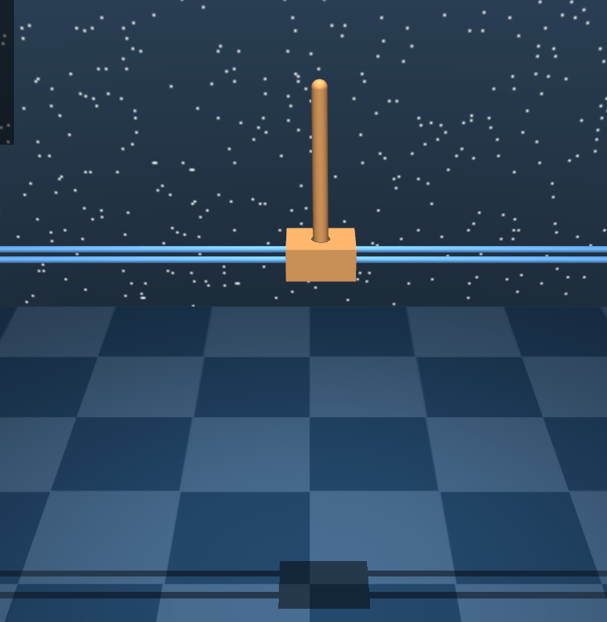
Cartpole
Training process noise std=0
Testing process noise std=0
Testing process noise std=0.01

Slide 30
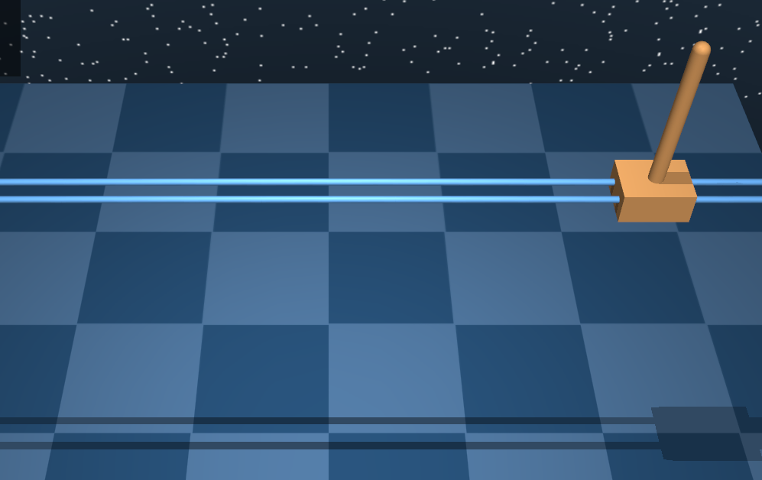
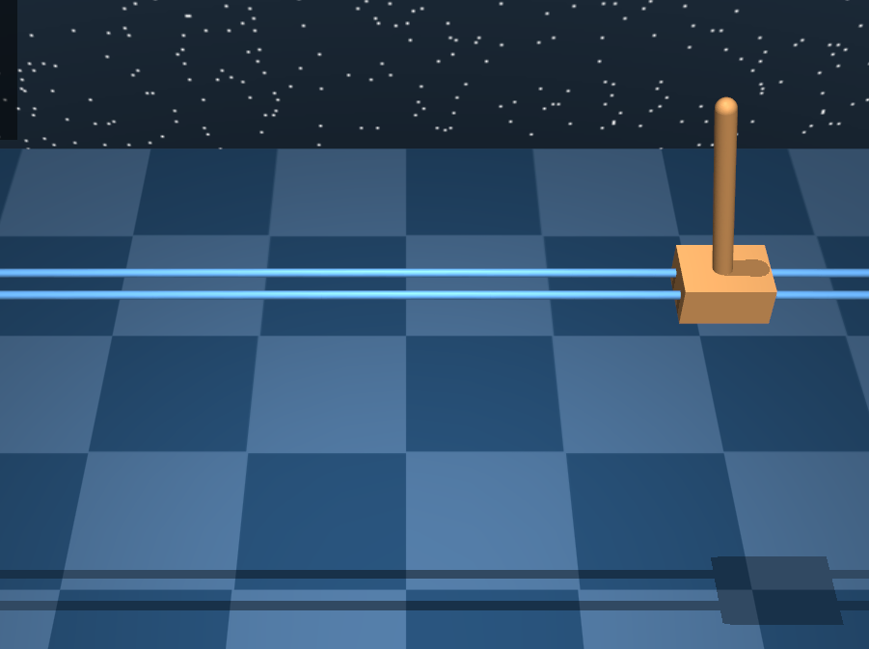
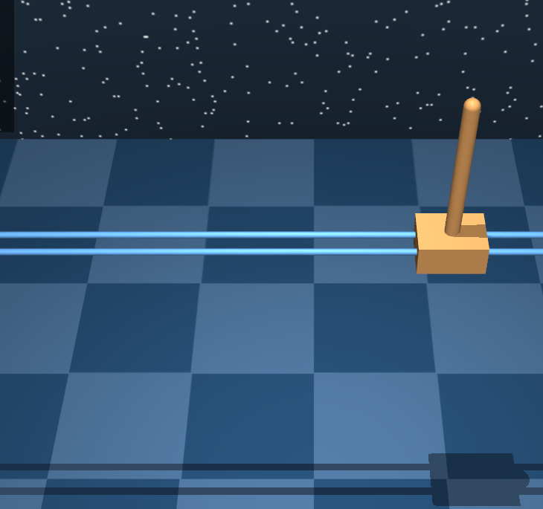
Cartpole
Training process noise std=0
Testing process noise std=0.05
Testing process noise std=0.1
Another one is out of frame

Slide 31
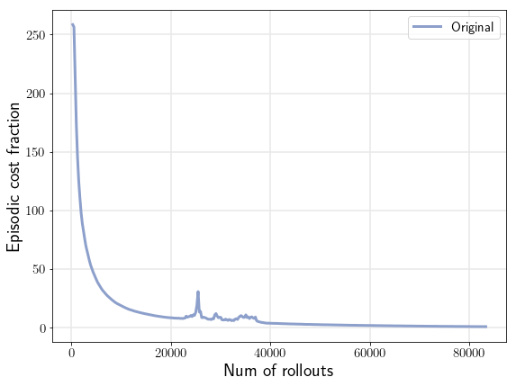
15.0s

Slide 32
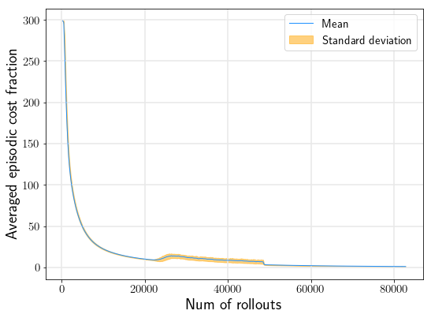
15.0s

Slide 33
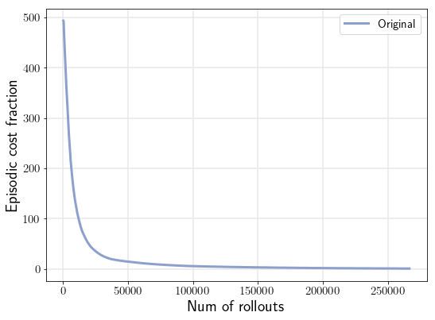
12.9s

Slide 34

12.9s

Slide 35

7861.0s

Slide 36

7861.0s

Slide 37

9489.3s

Slide 38

9489.3s

Slide 39

6011.2s

Slide 40


6011.2s

Slide 41

6011.2s

Slide 42

6306.7s

Slide 43

2261.2s

Slide 44

38833.6s

Slide 45

88160.0s

Slide 46

38833.6s

Slide 47


124367.6s

Slide 48


swimmer3

Slide 49


swimmer3

Slide 50

cartpole

Slide 51

cartpole

Slide 52

pendulum

Slide 53


1000runs
pendulum
cartpole

Slide 54

swimmer3

Slide 55

pendulum

Slide 56


cartpole

Slide 57


Pendulum 30 steps 0.1s/step
10 rollouts/ite
400 ites
1.41s

Slide 58




Pendulum 30 steps 0.1s/step
10 rollouts/ite
400 ites
Other runs

Slide 59


Pendulum 30 steps 0.1s/step
2 rollouts/ite
700 ites
0.56s

Slide 60


Pendulum 30 steps 0.1s/step
1 rollouts/ite
700 ites
0.39s

Slide 61


pendulum
Sysid=0.01s100rollouts 2cores
Lqr=0.004s
Umax=2.2
Terminal error no noise
No terminal control 0.2
Terminal control 0.34
About last 5 steps
No terminal control
terminal control

Slide 62


Training terminal cost

Slide 63


cartpole
Sysid=0.02s100rollouts 2cores
Lqr=0.007s
Umax=9.2
Training terminal cost
Terminal error no noise
No terminal control 0.28
Terminal control 0.75
About last 6 steps

Slide 64


Q=diag(100 100 1 1)

Slide 65



swimmer3
No terminal controller
About last 10 steps
About last 30 steps
With Terminal control 0.0047
With Terminal control 0.009
Value of Terminal error with no noise
No terminal control 0.0041
Umax=16.1

Slide 66


Slide 67

Some other cost function

Slide 68



swimmer6
0 steps
With terminal control = 0.044
18 steps
With terminal control = 0.035
46 steps
With terminal control = 0.038
Value of Terminal error with no noise
No terminal control =0.044
Umax=9.8

Slide 69

swimmer6

Slide 70


Cartpole 30 steps 0.1s/step
2 rollouts/ite
700 ites
0.61s

Slide 71


Cartpole 30 steps 0.1s/step
1 rollouts/ite
1000 ites
0.40s

Slide 72


pendulum

Slide 73


cartpole

Slide 74

Swimmer3

Slide 75


Swimmer3
Noise=0

